Slide 1

Inferring Locations in Twitter
SANDEEP MUPPIREDDY
SRIKANTH MATURU
SIDDHARTHA GANDHA
DANNEN GU

Slide 2
Overview
Background & Motivation
Applications & Basic Idea
Related Approach
Data collection & Filtering
Total Variation Minimization
Results & Evaluation
Future Work
Summary

Slide 3

Background
Huge data available in internet
Data annotated with geographic location is very useful
Annotated data has applications in business, research and
election forecasting
Traditional data gathering and public opinion collection
like online surveys, exit polls and door to door feedback
is time consuming

Slide 4
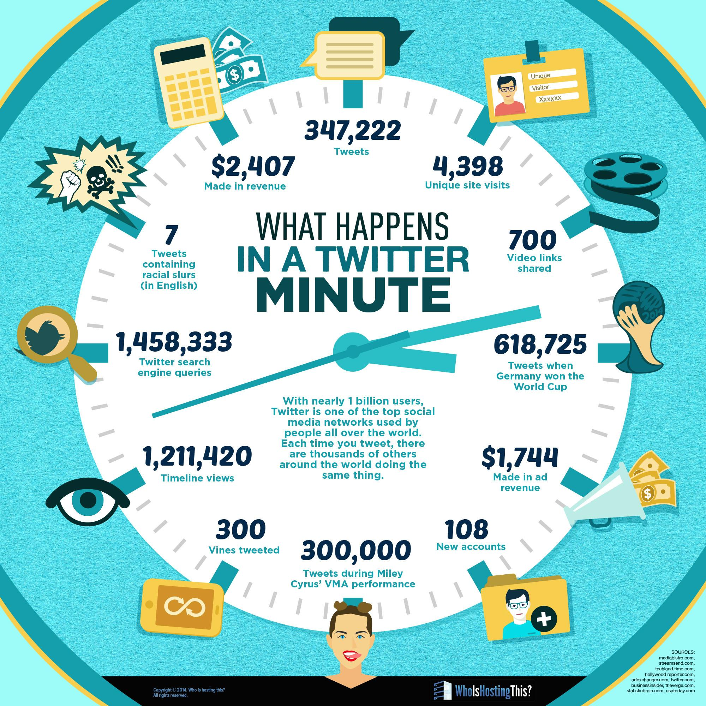
Twitter
Social media provides real time public opinions and product feedbacks
Twitter has 320 million monthly active users
500 million tweets per day on average
Finding locations of tweets has immense advantages

Slide 5
Motivation
Small percentage of twitter users share locations publicly
Location shared either through profile or annotating tweets by GPS location
Main objective is to geotag twitter users whose location is not shared publicly
Implement an algorithm that infers locations to twitter users

Slide 6
Applications
Disease trends
Election forecast
Product marketing
Disaster response
Social unrest

Slide 7
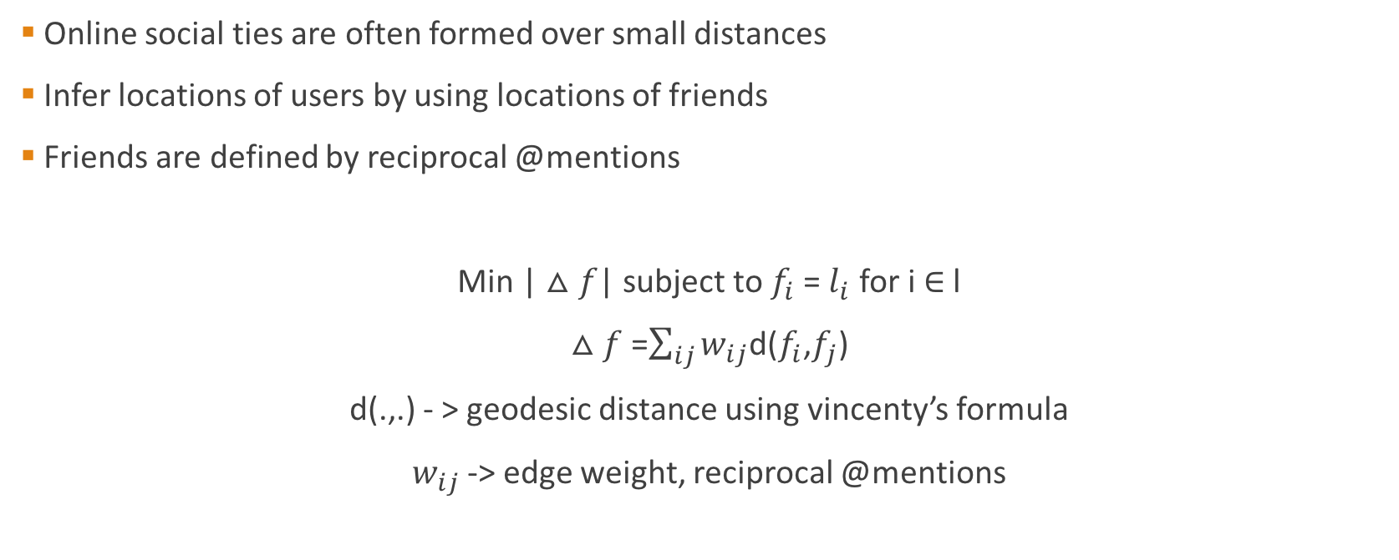
Basic Idea

Slide 8
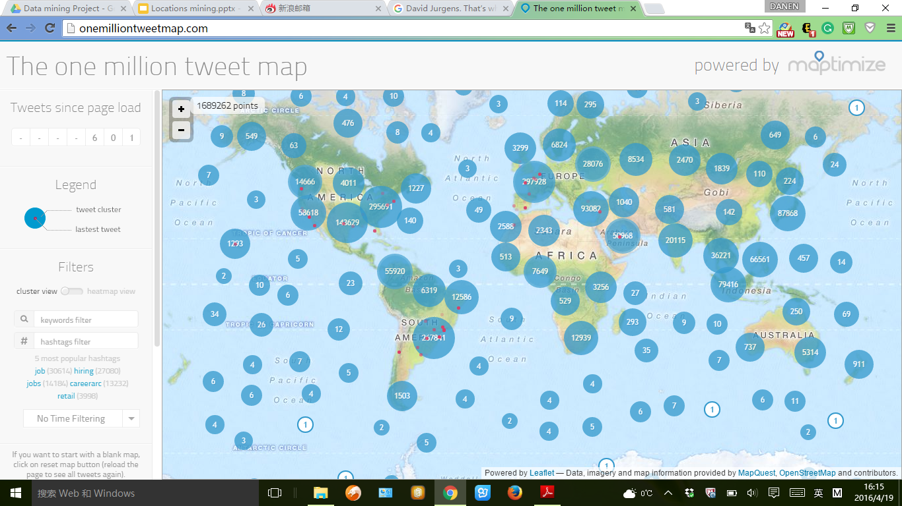




5
1
2
4
1
3

Slide 9
5
1
2
4
1
3

Slide 10


Slide 14
Related Approach
What is the easiest thing your friends can do for you?
To expose your locations!

Slide 15
Twitter Data
Twitter Data is public
Twitter API is used to access the real time tweet data
Twitter API requests are rate limited
15 min rate window
Twitter API resources used
◦Trends Resources
◦Tweets Resources
◦Friends/Followers Resources
◦User Timeline resources

Slide 16
Data Collection
Trends Resources
To obtain current trending popular hashtags/terms. Ex: #
Tweet Resources
Search real time tweets by hashtags, search terms
Friends/Followers Resources
Request list of friends and followers of a user
User Timeline Resources
List of users tweets from their timelines.

Slide 17
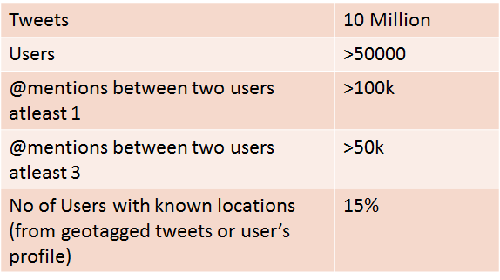
Data Collection

Slide 18
Ground Truth Locations
Function f - estimates the location of each user
Users opt to make locations public using
Cell phone enabled GPS
Self reported profile information
For this set of users computation of f is straightforward
Users never opt to make location preferences
Our goal to assign a value of f to these users

Slide 19

Ground Truth Locations
GPS enabled users may tweet from different locations
Idea is to assign unique location to user from set of GPS tagged tweets
We determined ground truth locations in such case by calculating
L1-multivariate median of the locations

Slide 20
Self reported profile location
Can be ambiguous
Pre-processing is needed to removed the noise
Prefer if they have GPS known locations
GeoNames, is world wide geographical information database
API is available to query a given location geo-coordinates using location name.

Slide 21
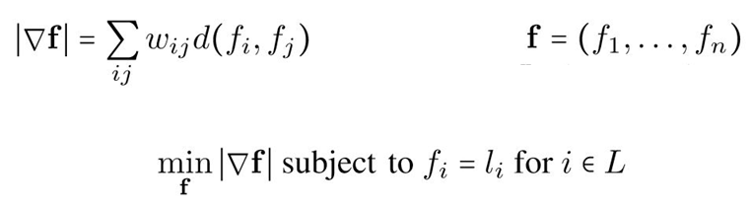
Total Variation Minimization
We use a network based approach to solve social media geotagging problem
Total Variation Minimization approach for estimating unknown locations of twitter users
Total Variation Minimization for geotagging problem can be defined as

Slide 22


Steps
We construct a Social Network with users as nodes.
Edges have weights
f is the desired function that encodes location estimate for users
f is fixed for users with known locations
For a given, f total variation is calculated by
We solve the equation for estimating unknown locations of twitter users.

Slide 24
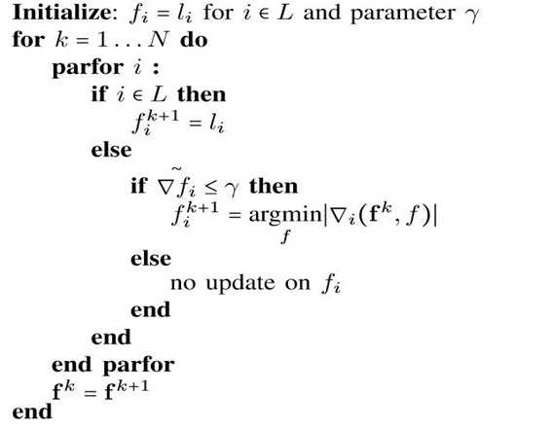
Algorithm

Slide 25
Evaluation & Results
Coverage
Total No of Users 52,356
No of Users with unknown locations 43,600
Remaining users locations are know either their GPS or self reported from their profiles.
No of Iterations | % of Users tagged
1 | 30%
5 | 40%
10 | 70%

Slide 26
Future Work
Collected Twitter data
Scarce with location details
@mentions resembles the friends and social ties
Synthetic data
Plan to work and evaluate results on large scale data specific to geographic location
Evaluating the estimation of per user accuracy to ensure that errors remain small

Slide 27
Summary
Geospatially indexing large volume twitter data - valuable for wide range of applications
Addressing social media Geotagging problem which is relatively new with respect to total minimization method
Overcoming the challenges of collecting data for the purpose of testing, evaluating by hiding certain percentage of data which have locations for users

